Slide 1


FY23 Governmentwide Section 508 Assessment
GSA Government-wide IT Accessibility Program and
U.S. Access Board
March 2024

Slide 2
Agenda
About Us
Assessment Mandate and Background
Drafting of Criteria
Creating the Reporting Tool
Assessment Outcomes

Slide 3
About Us
GSA Government-wide IT Accessibility Team
Host Section508.gov and assist with technical support, guidance, and advice to agencies and individuals with questions and issues relating to implementation of Section 508 requirements.
Focus on providing support to federal agencies in the following primary areas:
Policy and Program Management
Accessible Acquisition
Content Creation
Accessible Design and Development
Accessibility Testing
Accessibility Training and Events
U.S. Access Board (USAB)
Develop and issue the Section 508 accessibility standards.
Provide technical assistance and training on Section 508 to federal agencies.
Support the development of accessibility tools and best practices.
Contribute to U.S. and worldwide accessibility communities in support of agency mission to promote equality for people with disabilities.

Slide 4
Assessment Mandate and Background
GSA in consultation with Office of Management and Budget (OMB) and US Access Board, provides:
Comprehensive assessment of Section 508 compliance at both the reporting entity and government level
Recommendations for improving Section 508 compliance
GSA actions taken in the last 12 months and those to be taken in the next 12 months to improve accessibility across government
Dec 2022
April 2023
August 2023
Dec 2023
Assessment Mandated
Criteria publicly released
Responses submitted
Assessment Report Submitted
January to March 2023
Criteria Development
April to August 2023
Data Collection/Tool Release
August to December 2023
Report and Approval

Slide 5
Criteria and Tool Development

Slide 6
Criteria (Question) Development
Reviewed existing models for accessibility maturity
Reviewed general models of maturity
Discussed and generated questions to address information and communications technology (ICT) conformance across government
Conducted iterative process to refine and develop questions looking to balance three primary factors:
Importance of the criteria (i.e., relevance)
Analytical benefit of the criteria. Will it accurately describe the accessibility situation for that specific topic?
Burden/Level of effort for agencies to respond

Slide 7
Assessment Criteria
43 Accessibility Maturity Questions
Questions focus on assessing maturity and health of respondent accessibility. Categories are:
IT Accessibility Program Office
Policies, Procedure and Practices
Acquisition and Procurement
Technology Lifecycle Activities
Testing and Validation
Communications
Content Creation
Training
Human Capital, Culture and Leadership
40 Conformance Questions
Questions focus on specific conformance metrics for: web, hardware, software, documents, selected enterprise applications, and targeted program outcomes.
22 General Information Questions
Questions collect general and background information on the program including: federal full time equivalents (FTEs), contracting support, financials, task organization, and complaints, among others.
Instructions and criteria are available at Section508.gov/section-508-assessment/
Notes:
Instructions and criteria are available at https://www.section508.gov/manage/section-508-assessment/criteria-01/

Slide 8
Tool Development & Release
Given the tight timeframe and limited resourcing, the assessment team was limited to the tools we could employ.
Decided upon a survey form tool used across government.
Interfaced directly with the development team and developed custom code ourselves to ensure accessibility of the tool.
Released tool for vendors, but had to compromise some user experience items to ensure accessibility
Conducted over 15 office hour sessions to assist organization points of contact with finding the correct info, understanding the tool and questions and submitting their responses

Slide 9
Assessment Analysis

Slide 10
Employed Analytical Approaches
The Assessment team analyzed the self-reported data from 249 reporting entities over the June 1, 2022 to May 31, 2023 reporting period using the following methodologies:
Indexing Analysis: Assessed all entities on a ranged scale so they could be compared against an ideal state of accessibility conformance
Scales included business function maturity and operational performance
Overall Performance Group Statistics: Analysis using Likert-like (5 point) scales to bin entities using their indexes to create like groups called categories
Descriptive Statistics by Question: Analysis of government-wide outcomes by assessment criteria
Regression and Correlation Analysis: Analysis attempting to discern patterns and relationships between entity accessibility characteristics

Slide 11
Highlighted Findings and Recommendations

Slide 12
Highlighted Finding #1
Section 508 Compliance Can Be Improved Across Government

Slide 13
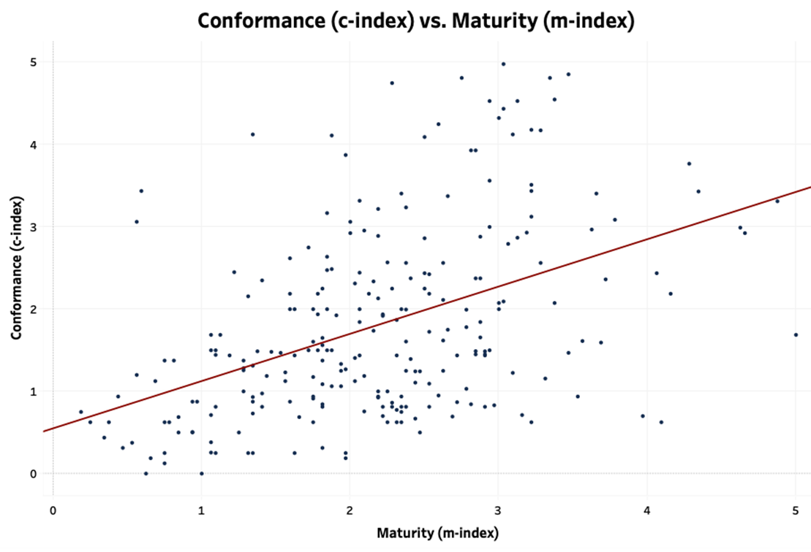
Overall Performance Across Government
Responses from 249 reporting entities revealed the government as a whole is not meeting the statutory requirement of Section 508 to provide equal access to all members of the public and federal employees with disabilities.
 | Very Low Maturity | Low Maturity | Moderate Maturity | High Maturity | Very High Maturity
Very High Conformance | 0 | 2 | 6 | 9 | 0
High Conformance | 2 | 3 | 8 | 5 | 3
Moderate Conformance | 0 | 12 | 23 | 8 | 4
Low Conformance | 4 | 39 | 37 | 5 | 1
Very Low Conformance | 21 | 25 | 27 | 4 | 1

Slide 14
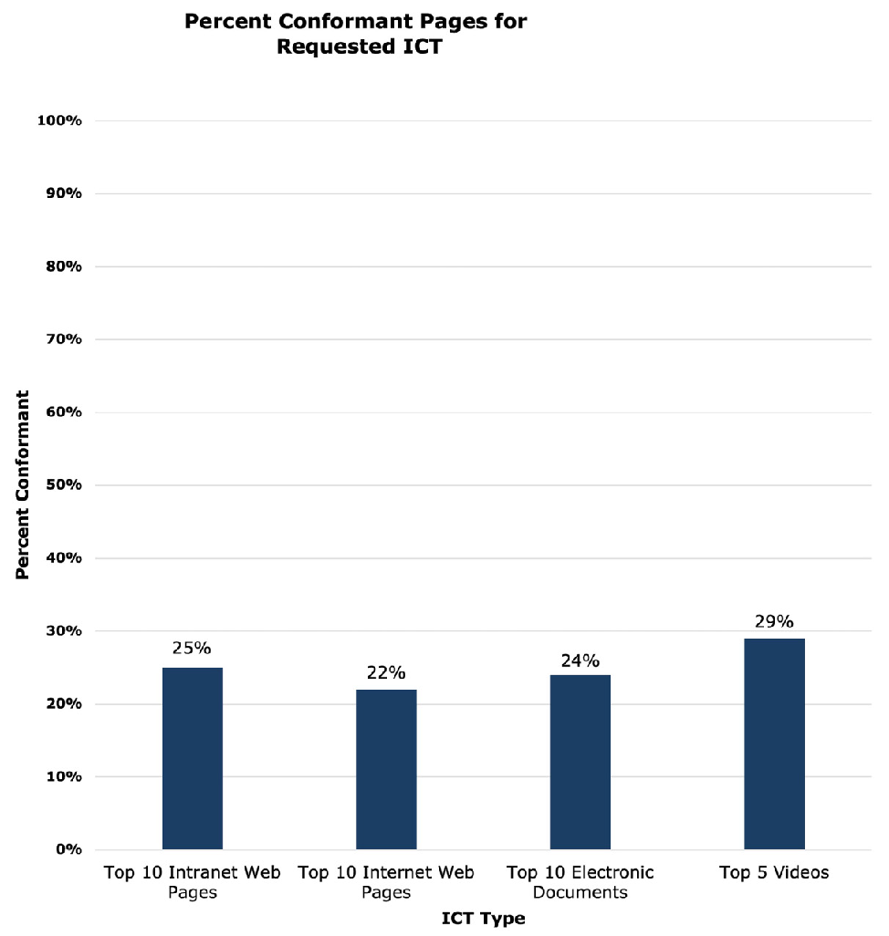
The Majority of Top-Viewed ICT Tested Do Not Fully Conform to Section 508 Standards Of the self-reported top 10 viewed intranet and internet pages, top 10 viewed electronic documents, and top five viewed videos, less than 30% fully conform to Section 508 standards.

Slide 15
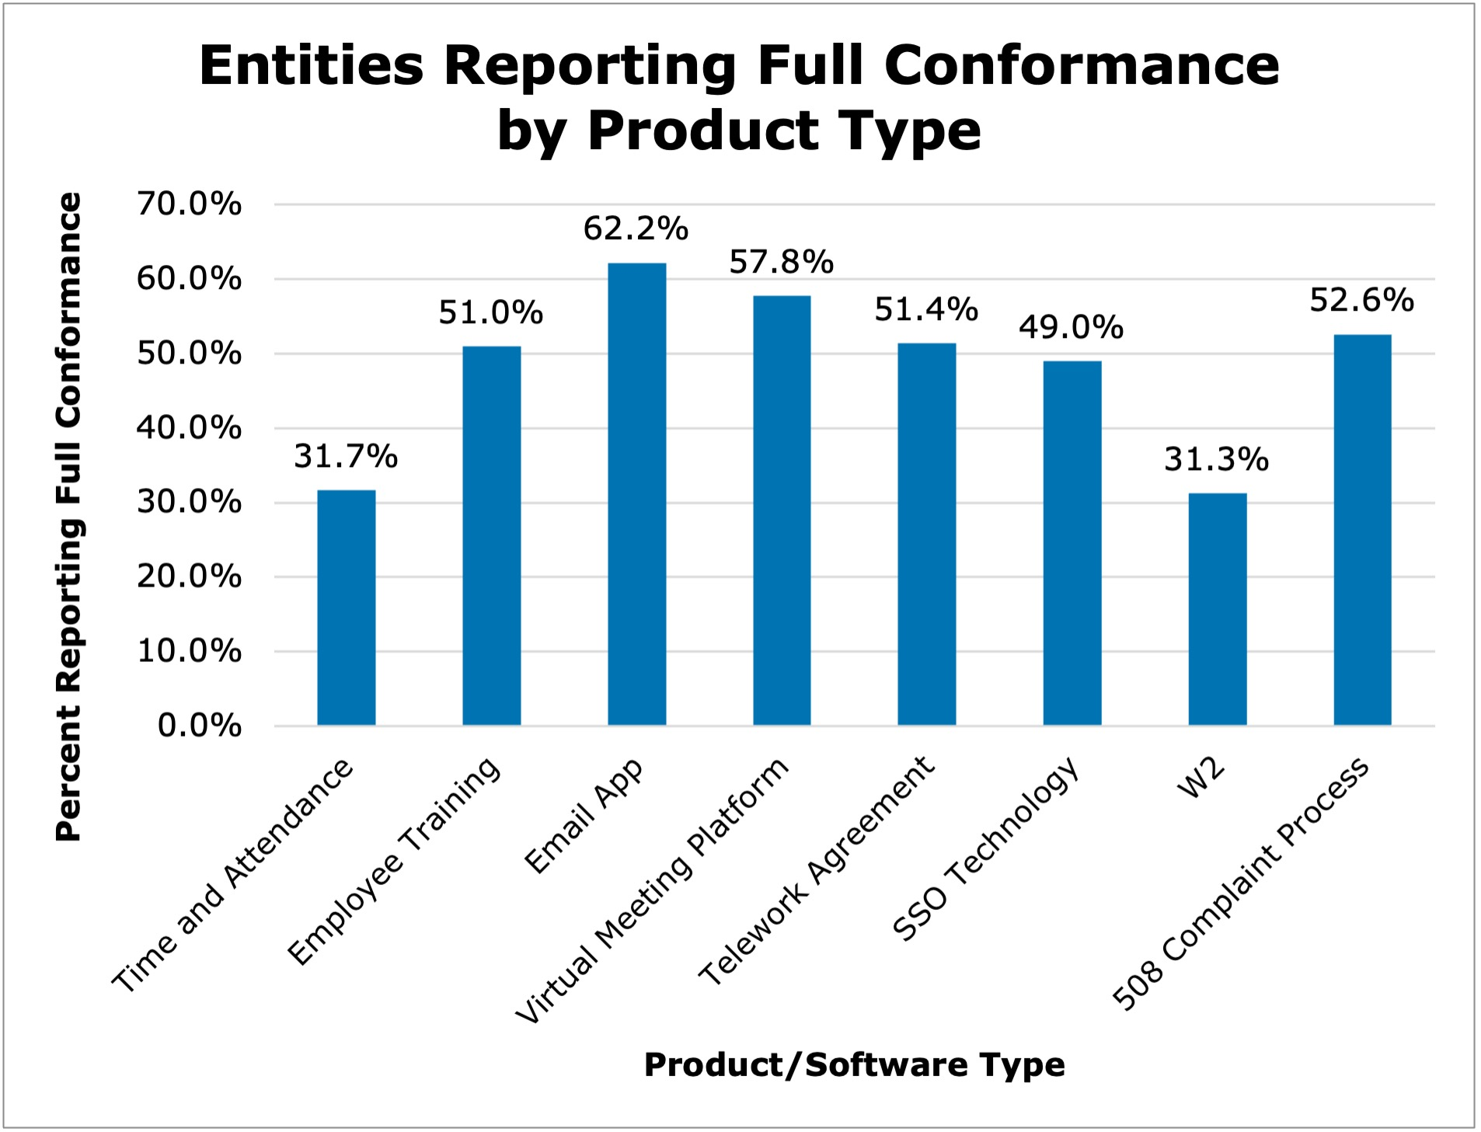
Top ICT Compliance Outcomes
The self-reported conformance information for common digital technologies used within agencies shows:
The highest conformance was 62.2% for agency email applications.
The lowest was 31.3% with organization W2s.
Every instance of noncompliance with Section 508 captured in this data is an indicator federal employees with disabilities and members of the public are impeded or excluded in their interactions with federal ICT.

Slide 16
Highlighted Compliance Recommendations
Target Accessibility of High-Use Software:
Congress should consider conducting oversight efforts into major providers of ICT to the federal government to determine the best course of action for improving accessibility of high-use products.
Share Best Practices:
Agencies should more actively engage with the digital accessibility community, GSA, and the Access Board to develop and share best practices.

Slide 17
Highlighted Finding #2
Resources Are Impactful

Slide 18
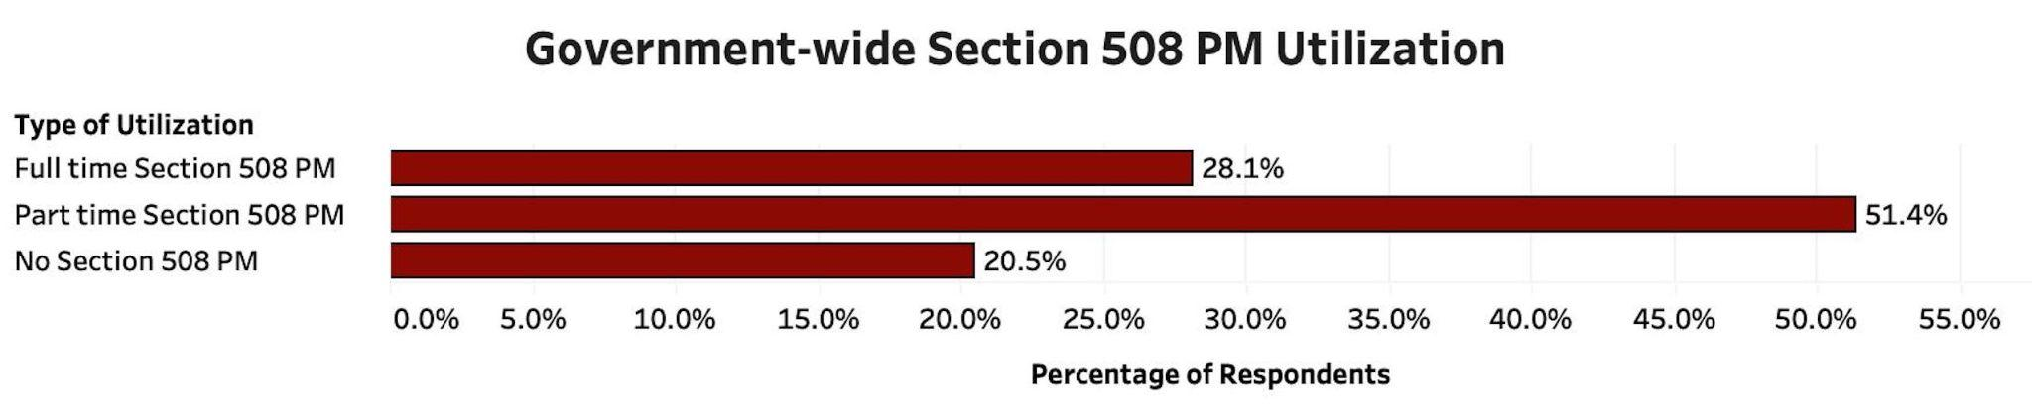
Section 508 Program Manager (PM) Utilization
Maturity Bracket | Average Section 508 PM Hours Spent per Week
Very High | 31 hours
High | 26 hours
Moderate | 19 hours
Low | 10 hours
Very Low | 3 hours
Entities with higher Section 508 PM participation tend to have more mature Section 508 organizations.
Section 508 PMs across government spent an average of 15.4 hours per week on Section 508.

Slide 19
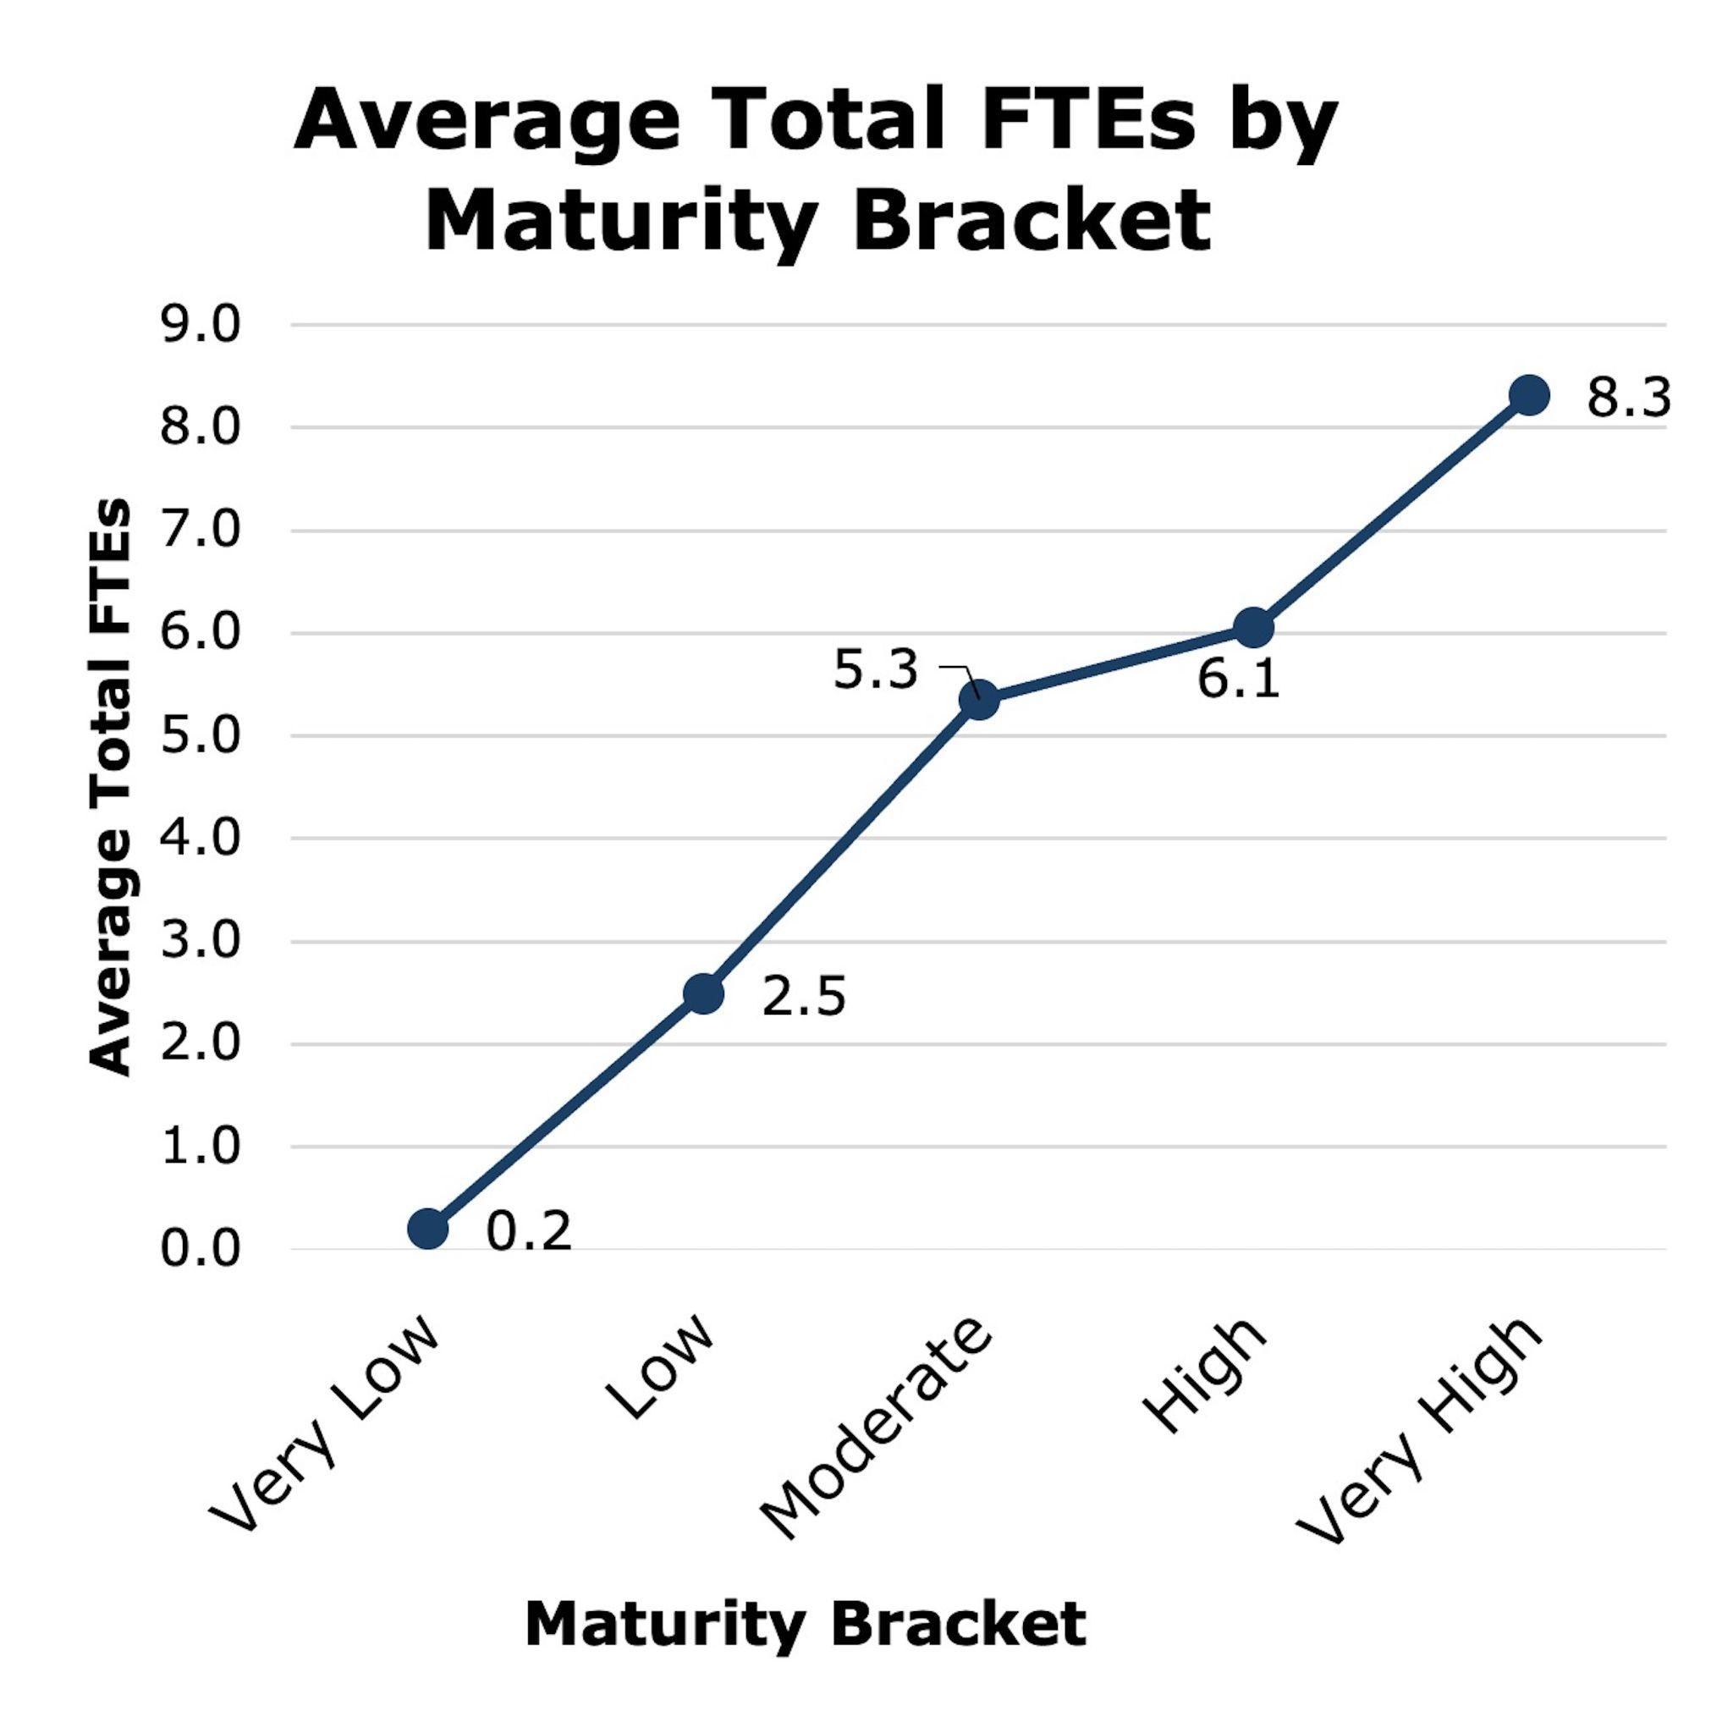
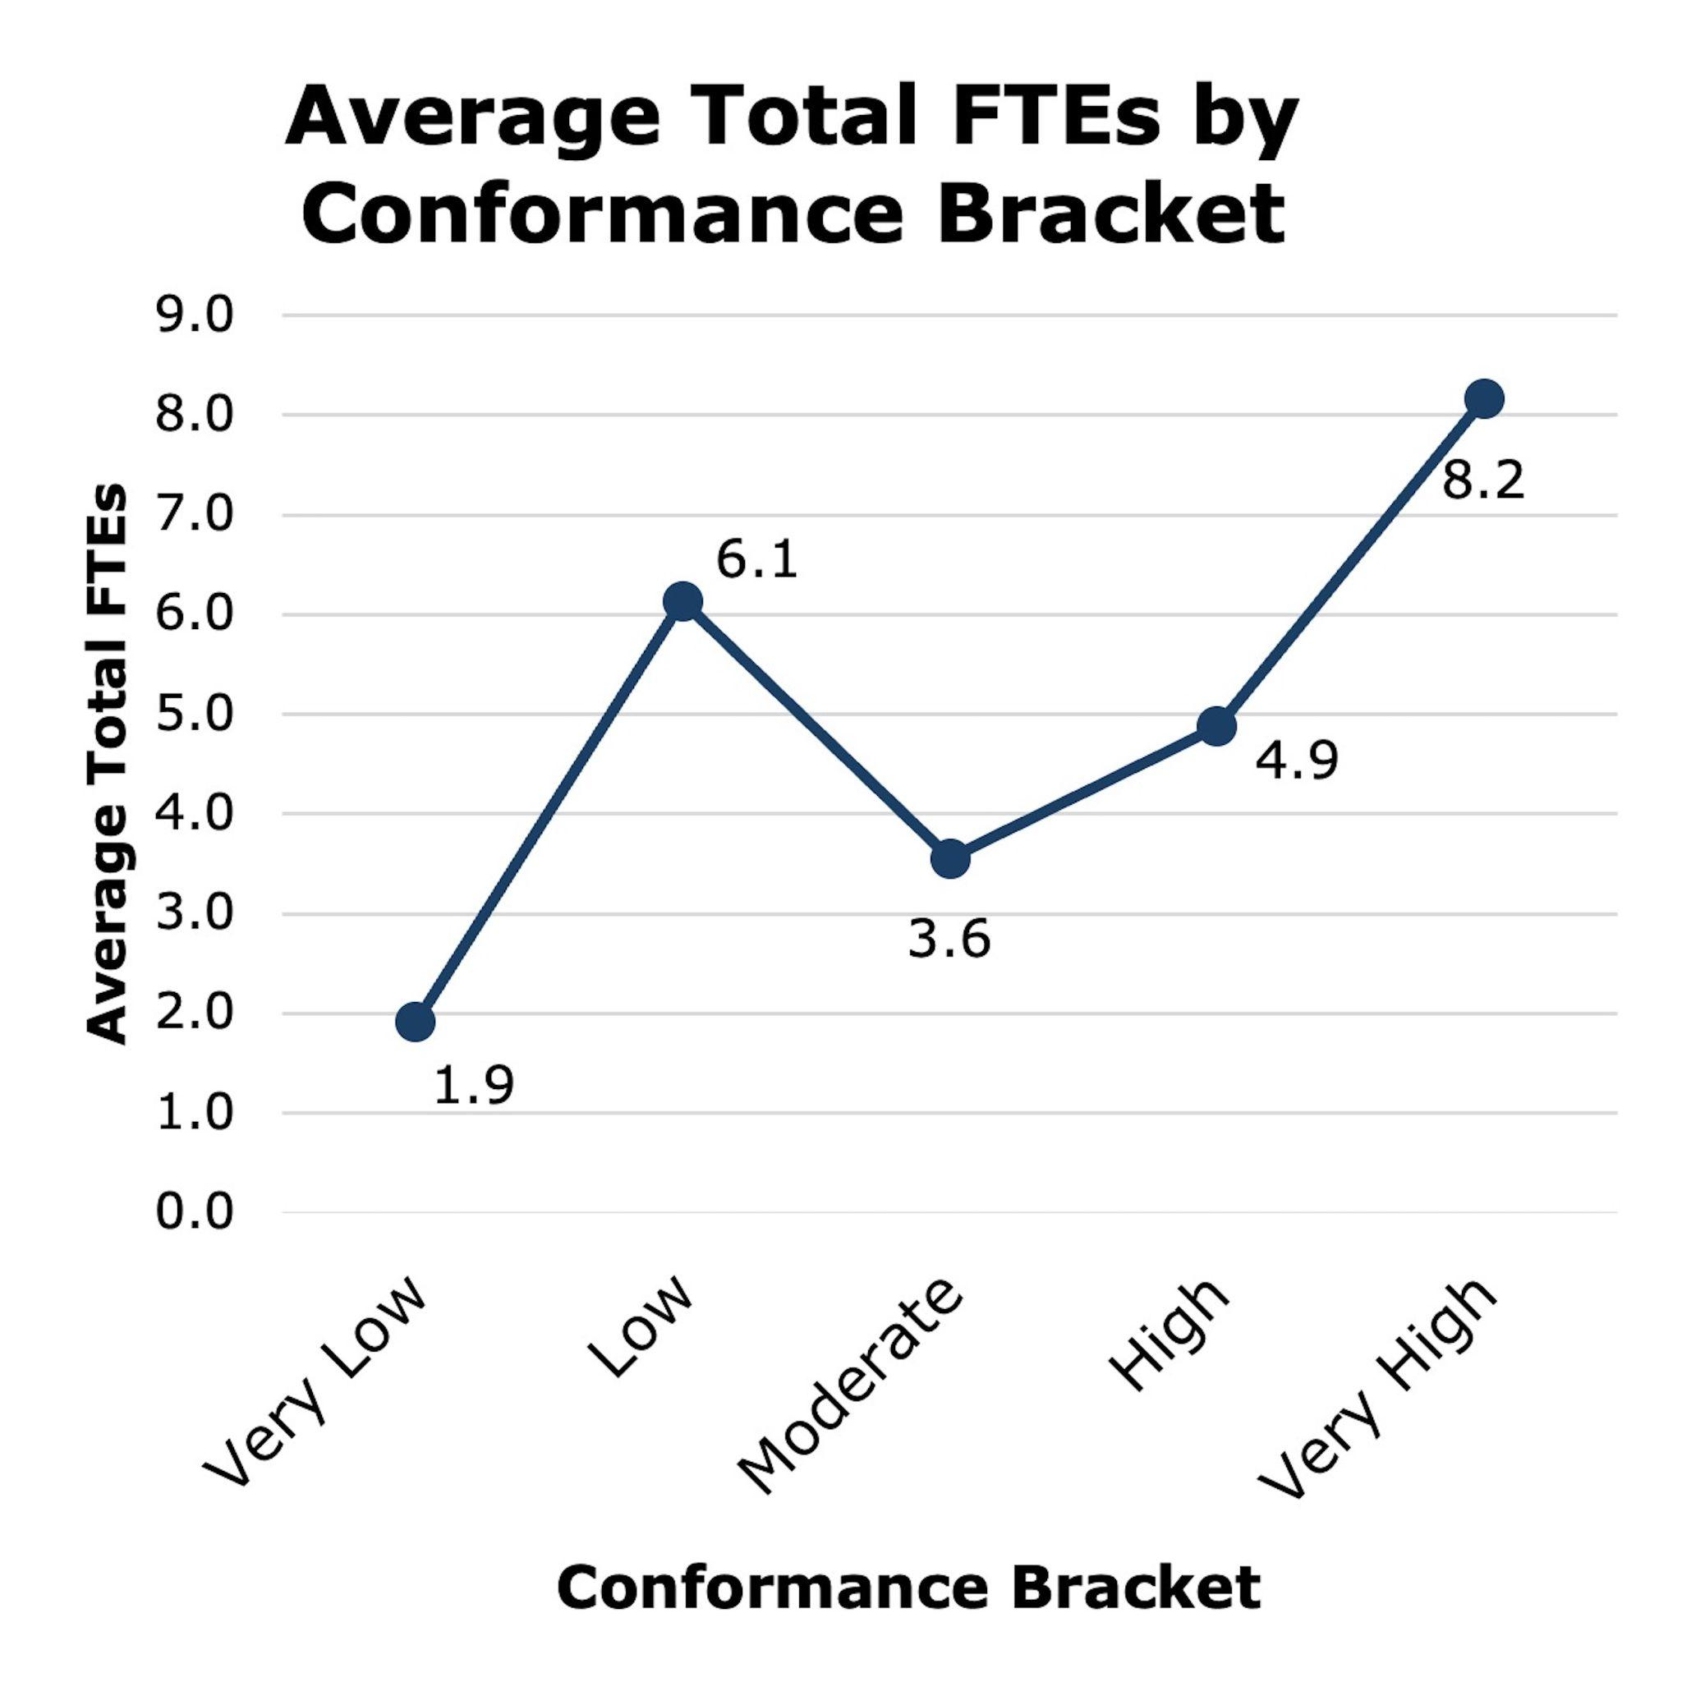
FTE by Maturity and Conformance Bracket
More mature entities tend to have more FTEs.
Entities with better conformance outcomes tend to have more FTEs.

Slide 20
Highlighted Resourcing Recommendations
Ensure Sufficient Section 508 Program Manager (PM) Utilization:
Agencies should have an assigned Section 508 PM with utilization and authority that is proportionate and sufficient to ensure an effective Section 508 program.
Ensure Sufficient Section 508 Program Resourcing:
Agencies should consider including information about Section 508 program capacity in annual budget requests to highlight necessary resources to improve ICT accessibility.

Slide 21
Next Steps and Contact Information

Slide 22





Next Steps FY24
Intake feedback and update the criteria
Develop the tool and expand capabilities while ensuring input accessibility
Build the assessment in the tool
Release tool with updated criteria to responding agencies for FY24 data collection
Assist agencies with tool and criteria questions as they develop their response

Slide 23
Contact Information
Contact the GSA Government-wide IT Accessibility Program:
Visit our Contact Us page at www.section508.gov/contact-us/
Contact us via email at section.508@gsa.gov
Contact the U.S. Access Board:
Access Board Contact Us page (www.access-board.gov/contact/)
Email: 508@access-board.gov
Phone: (202) 272-0080, extension 3 (voice)
Fax: (202) 272-0081
Notes:
Contact the GSA Government-wide IT Accessibility Program:
Visit our Contact Us page at https://www.section508.gov/contact-us/
Contact us via email at section.508@gsa.gov
Contact the U.S. Access Board:
Access Board Contact Us page (https://www.access-board.gov/contact/)
Email: 508@access-board.gov
Phone: (202) 272-0080, extension 3 (voice)
Fax: (202) 272-0081

Slide 24
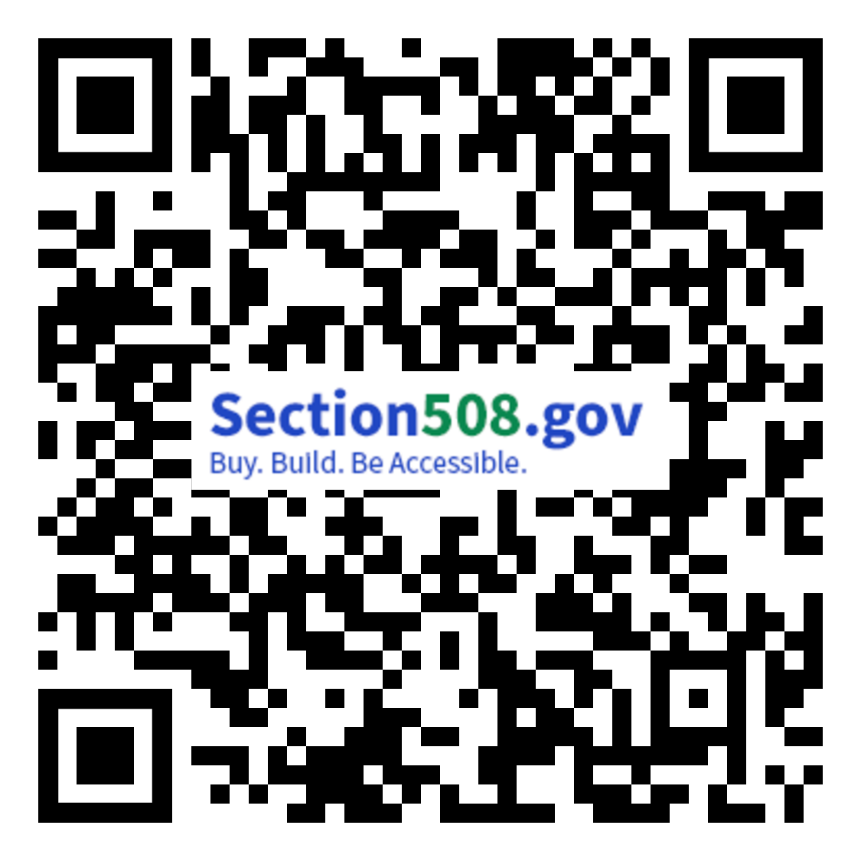
Access to the FY23 Report, Data and Criteria
The web version of the report is available at: Section508.gov/2023-congressional-report/
A downloadable version of the report, respondent data, and other content related to the Assessment is available at Section508.gov/2023-congressional-report-downloads/, including:
FY 23 Governmentwide Section 508 Assessment (PDF) as transmitted to Congress on December 29, 2023
Reporting Entity Response Data for FY23 Government-wide Section 508 Assessment (CSV) and (JSON)
Regression Results for FY23 Governmentwide Section 508 Assessment
FY23 Governmentwide Section 508 Assessment Data Dictionary
Data Validation for FY23 Governmentwide Annual Assessment
Section508.gov/2023-congressional-report/

Slide 25
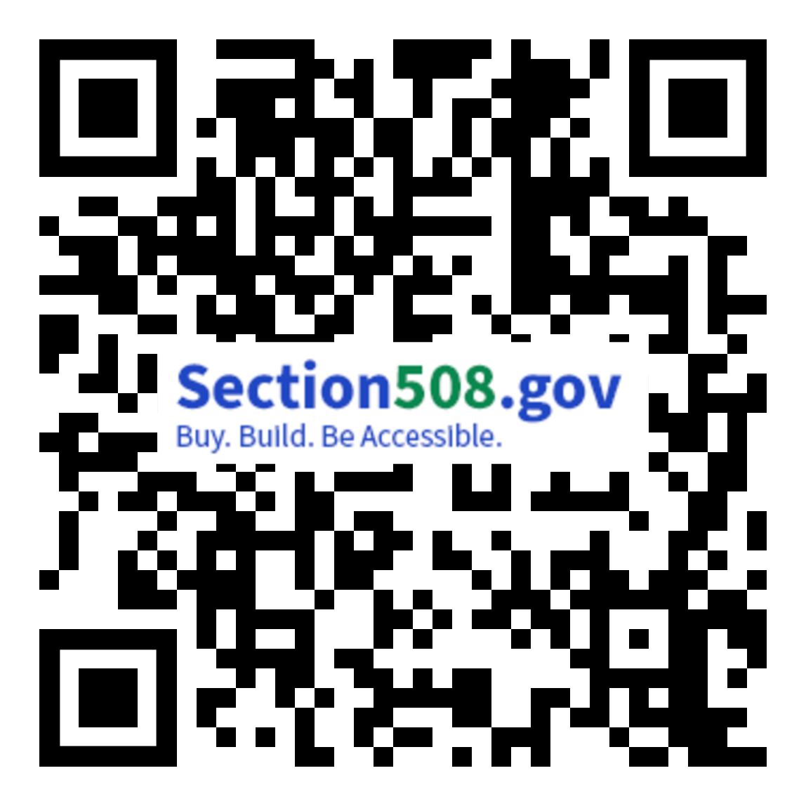
CSUN Sessions and Presentation Files
FED Talk - Section 508 Activities Update by USAB & GSA Tuesday at 10:20 a.m. in Grand GH
Section 508 ICT Testing Baseline Portfolio Wednesday at 10:20 a.m. in Grand GH
OpenACR: The Future of Accessibility Conformance Reporting Wednesday at 11:20 a.m. in Grand GH
Birds of a Feather Thursday at 12:00 p.m. in Platinum 9-10 Ballroom
Analytical Approach to the Governmentwide Annual Assessment Thursday at 3:20 p.m. in Orange County 1-2
Introduction to the Accessibility Requirements Tool (ART) Thursday at 4:20 p.m. in Grand JK
Section508.gov/csun2024/

Slide 26
Questions?

